Slide 1

AI-Powered Riverbank Erosion Risk Prediction and Early Warning System for Bangladesh
Course code : SE-331 | Section : 41 E1
Hasib ur Rahman (232-35-590)
Dhroubo Jyoti Mondal (232-35-182)
Masoud Ibna Mostofa (232-35-551)

Slide 2

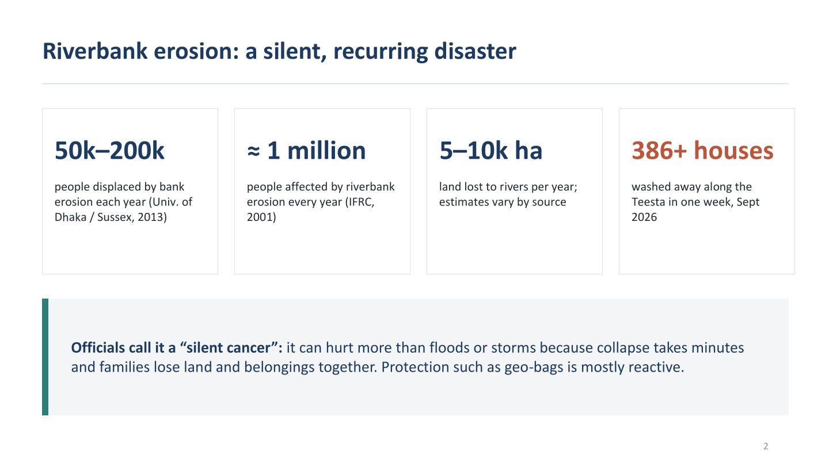

Slide 3
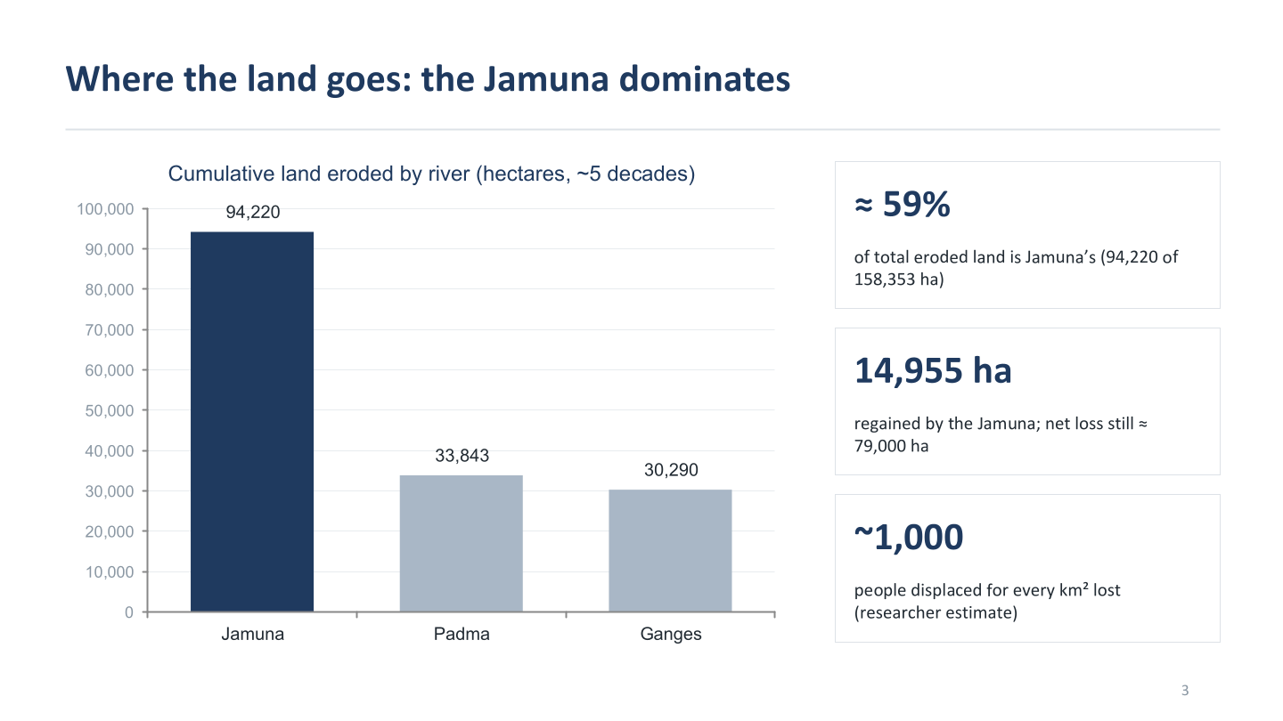

Slide 4
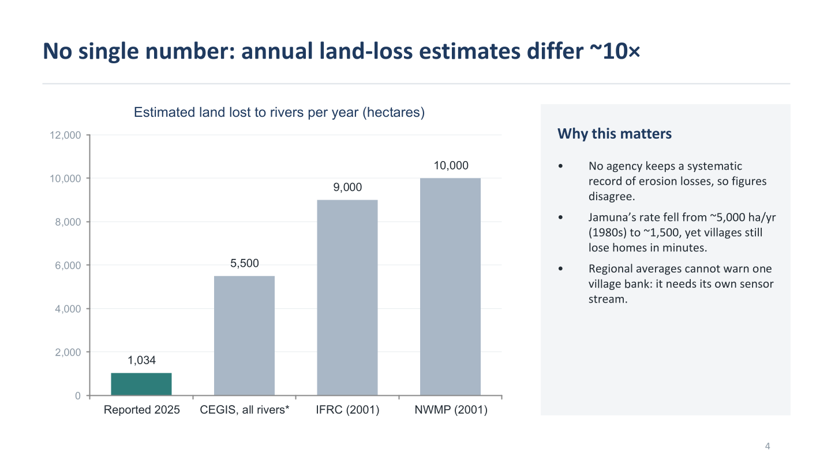

Slide 5
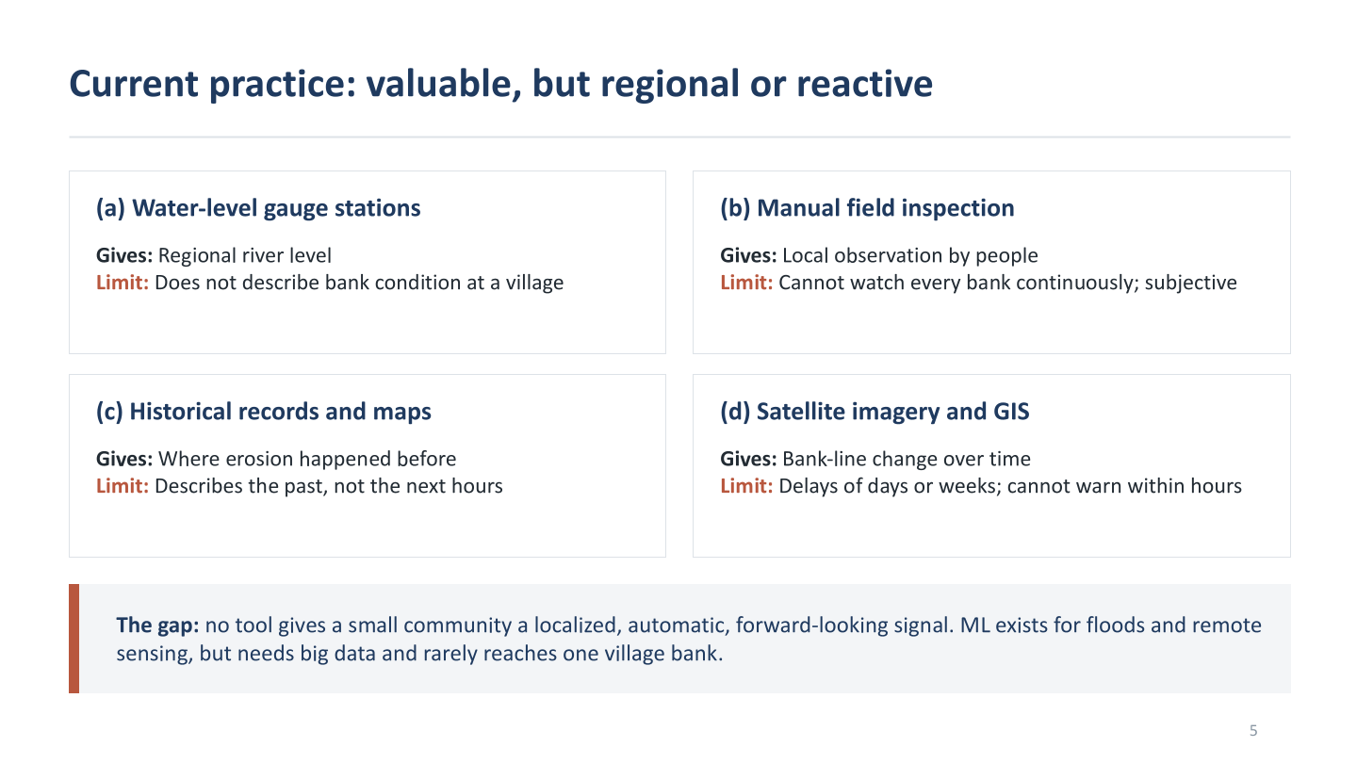

Slide 6
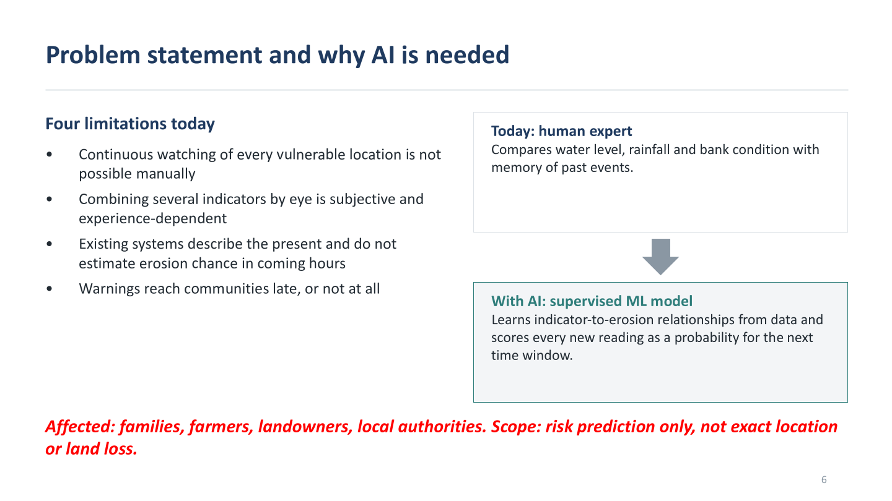

Slide 7
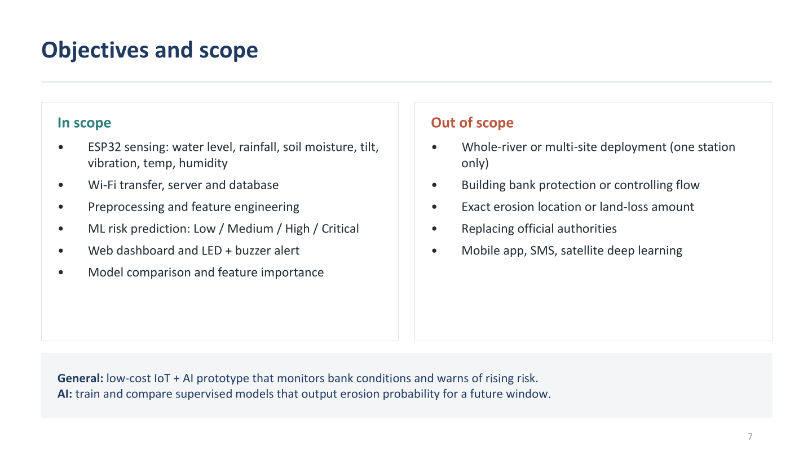

Slide 8
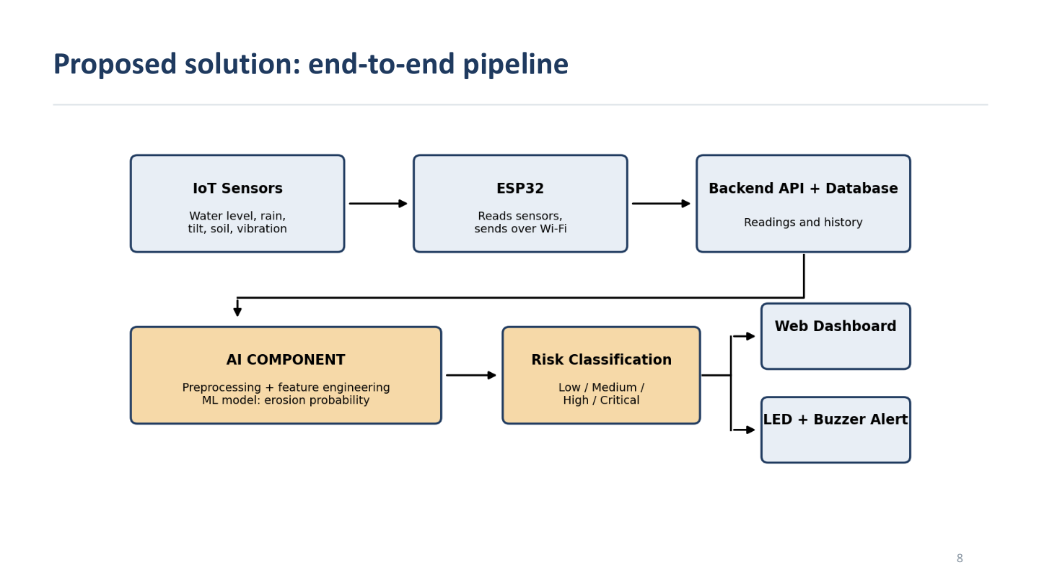

Slide 9
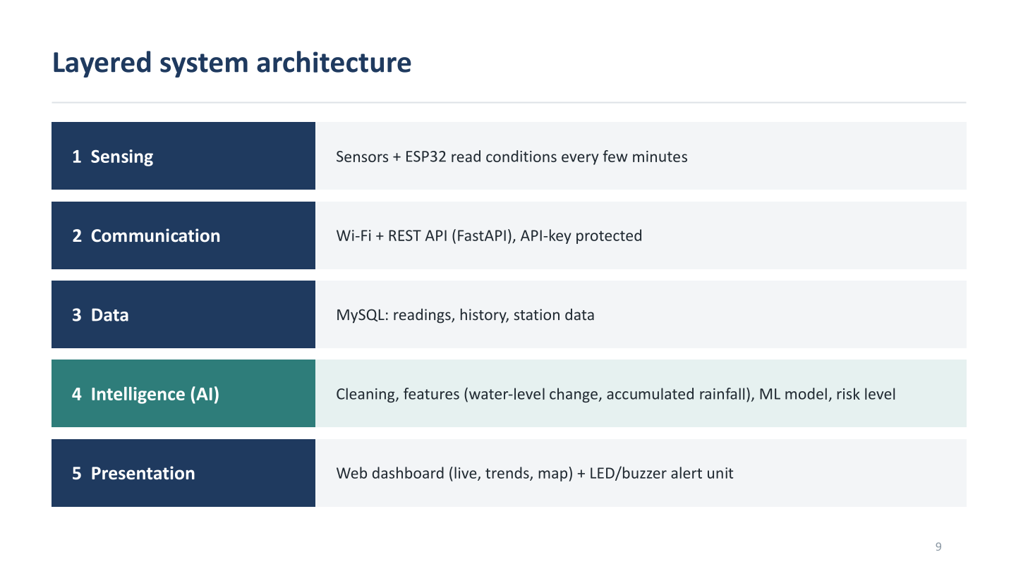

Slide 10
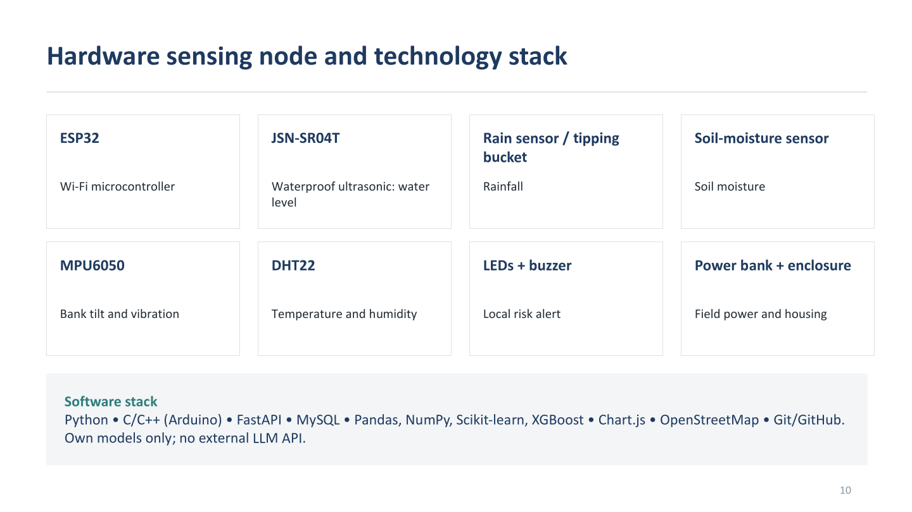

Slide 11
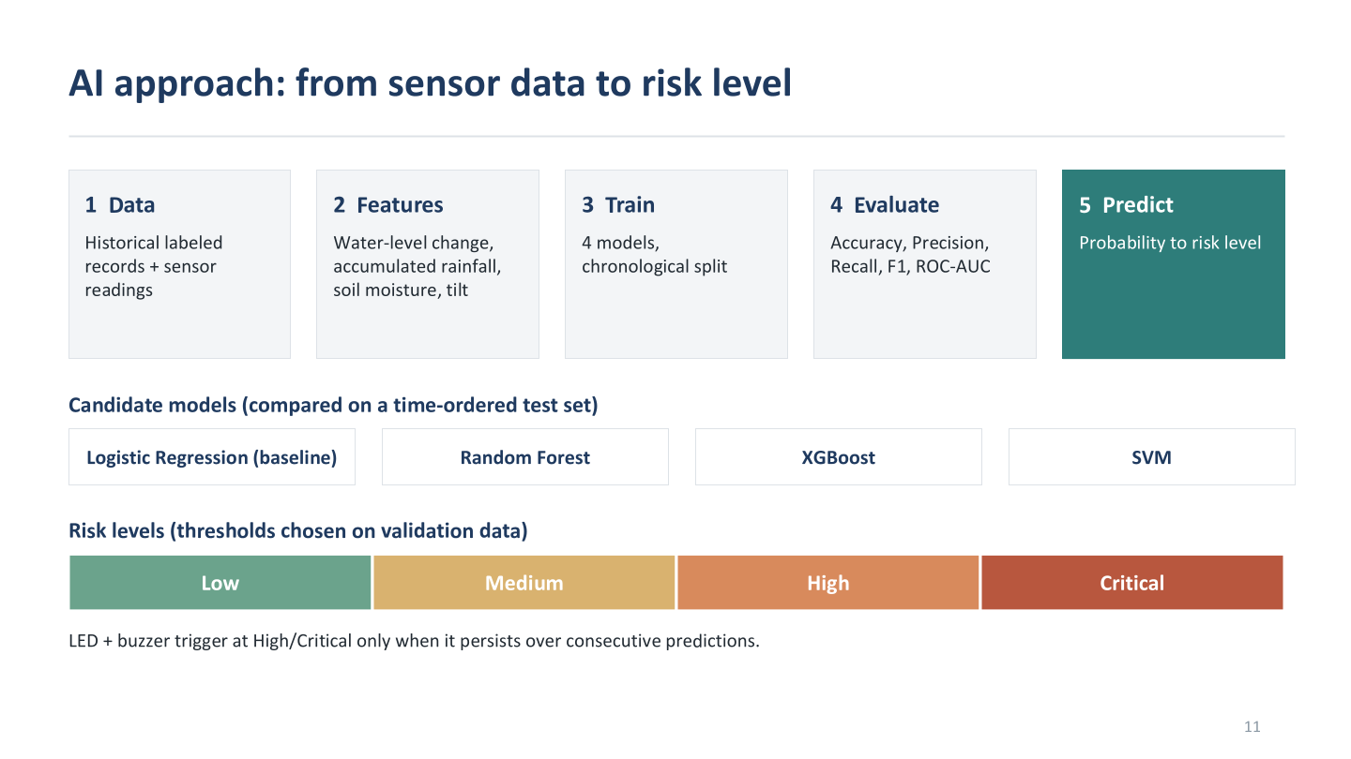

Slide 12
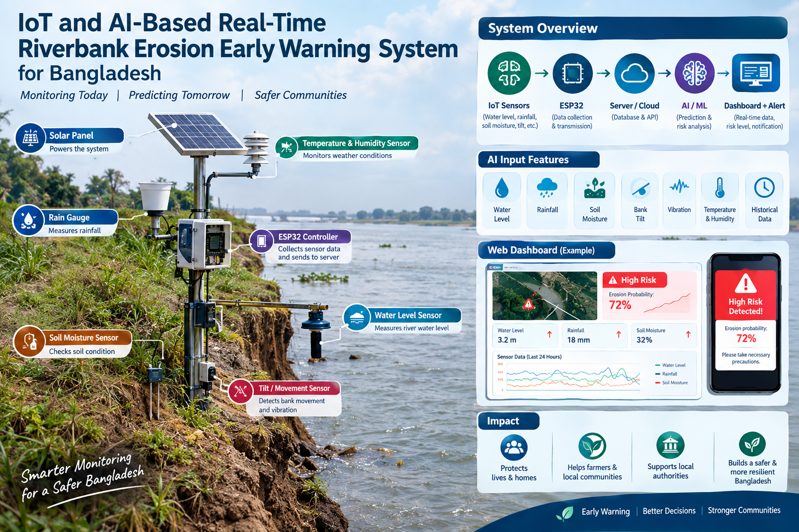

Slide 13
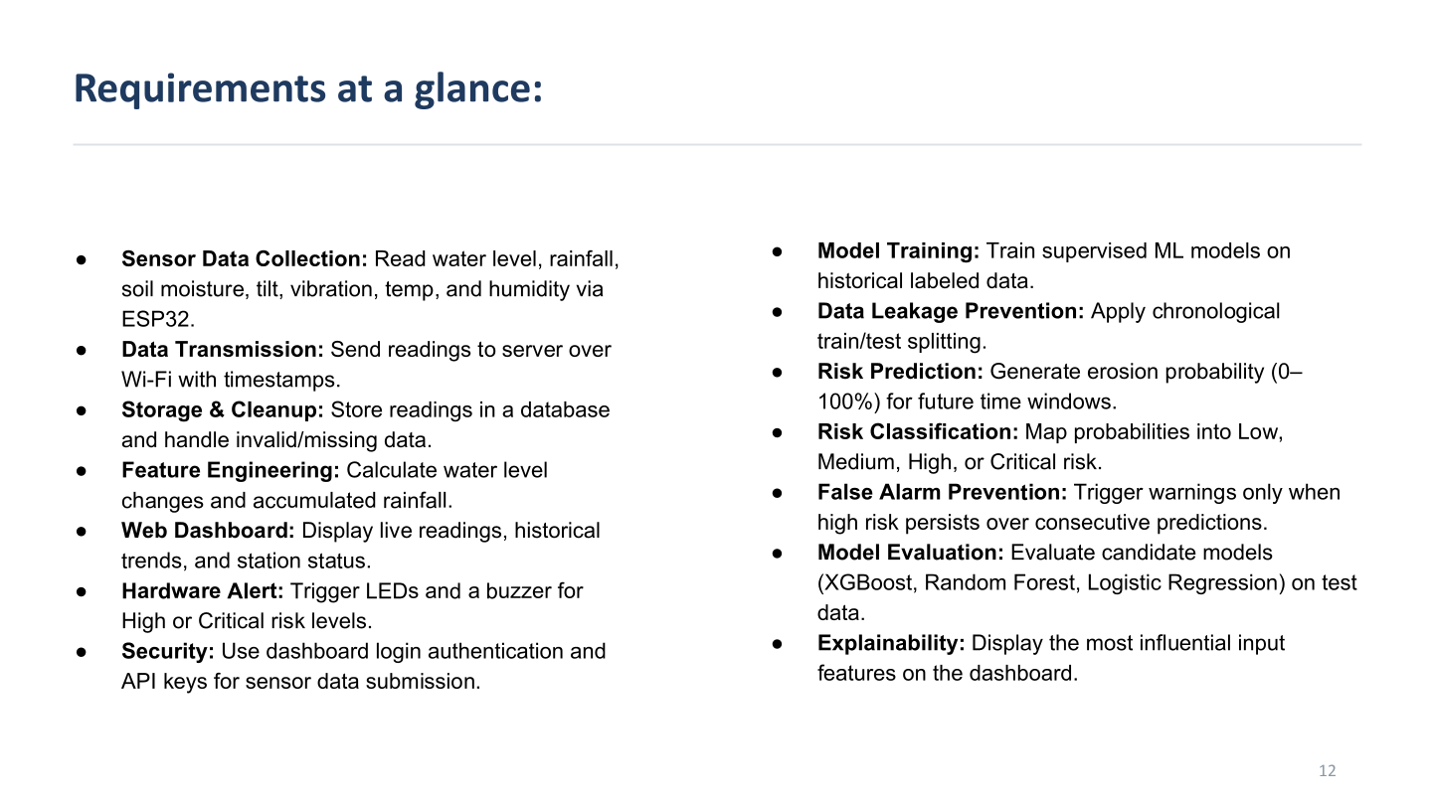

Slide 14
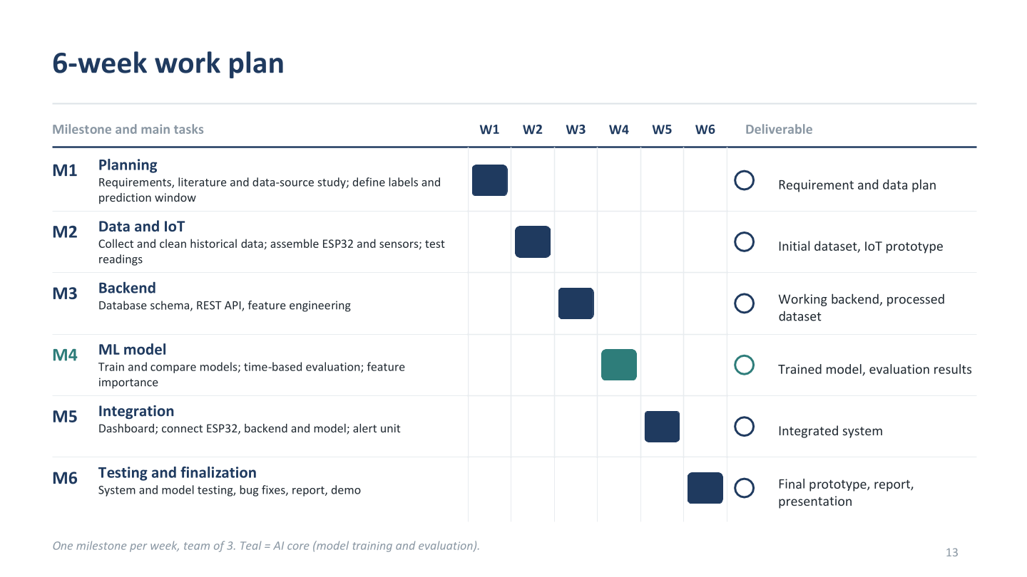

Slide 15


